Slide 1
Understanding emotions
Teen Mental Health Series Part 1
Chris Guzniczak, LPC
Flower Mound Counseling
www.chrisguzniczakcounseling.com

Slide 2
Overview of mental health series
Session 1: Understanding Emotions
Session 2: Change the Way you THINK
Session 3: Additional Strategies to deal with stress
This presentation is for informational purposes only and is not intended to be advise or counseling. If you would like counseling services, please contact Chris @ chrisguz.counseling@gmail.com
Notes:
We’ll start with understanding our emotions. Anxiety, frustration or anger, depressed
No matter what your stressed about (outside) – getting grades, playing a sport, college, friends, online classes, social injustice, other global unrest… its critical to start with a strong foundation (inside), being good with you. Accepting yourself, loving yourself, defending yourself.
Then, in session 2, we’ll talk about changing the way you see yourself and the things that are happening around you.
In session 3, we’ll continue with additional strategies to deal with stress, boredom, frustration, and so forth.
When you feel negative you can do 2 things to deal with it… distract (video game, snack, read, music, bike)… process (work through it)

Slide 3
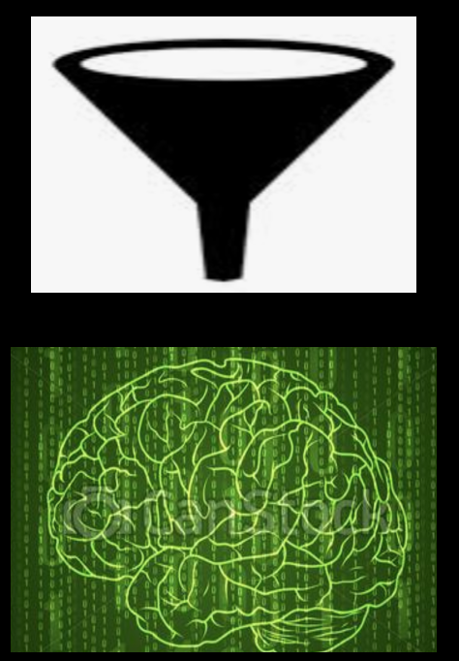
Your truth is… your truth
You FEEL the way you THINK
Negative thoughts that upset you are often distorted (not true)
When you change the way you THINK, you can change the way you FEEL
Notes:
3 very important point that will be the foundation of this class…
Feel way you think – means you don’t have an emotion, feel, without thinking something first – example. If my friend yells at me I might think… I’m. bad friend and feel guilty, or she shouldn’t ay that and feel angry, or I may lose my friend and feel sad…
Those thoughts – twisted – like we have a funnel over our head input combined with experiences, knowledge, relationships, beliefs, expectations, etc – truth
Learn how to change the way you think
We can’t always change our circumstances, but we can think about them differently

Slide 4
Understanding our emotions
POSITIVE REFRAMING ACTIVITY
Learning points:
There are logical reasons that you feel the way that you do
Negative feelings don’t define you
They actually point to what is great about you!!

Slide 5
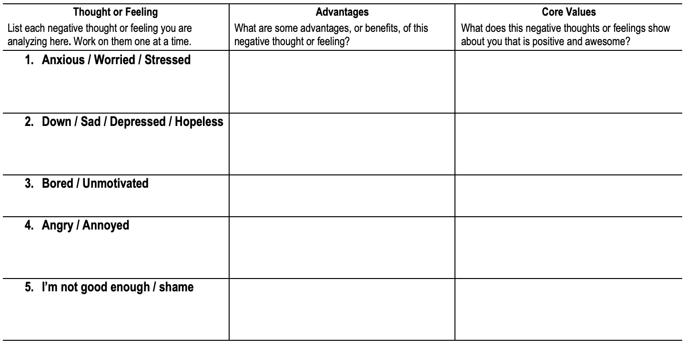
Positive Reframing
Notes:
The activity we’re going to do today is called positive reframing. This is a technique developed by Dr David Burns with the Feeling Good Institute. We are going to learn to accept our negative feelings. Instead of assuming that they mean something is wrong with us, we’re going to explore their value.
Painful emotions are like having a deep cut on your arm. The least painful way to deal with it is to leave it be and let it callous over. That way, it doesn’t hurt as much.The problem is, that in the long run it’s not healing and it will get much worse. You really need to go in and clean it all out. It really hurts, but it allows healing to happen. It’s the same with our negative emotions. And the first step is to understand them.

Slide 6
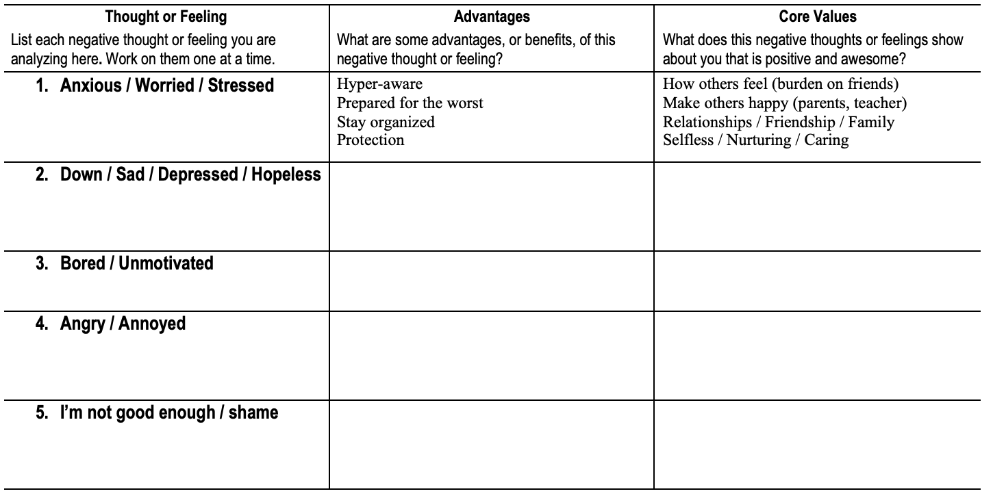
Positive Reframing

Slide 7
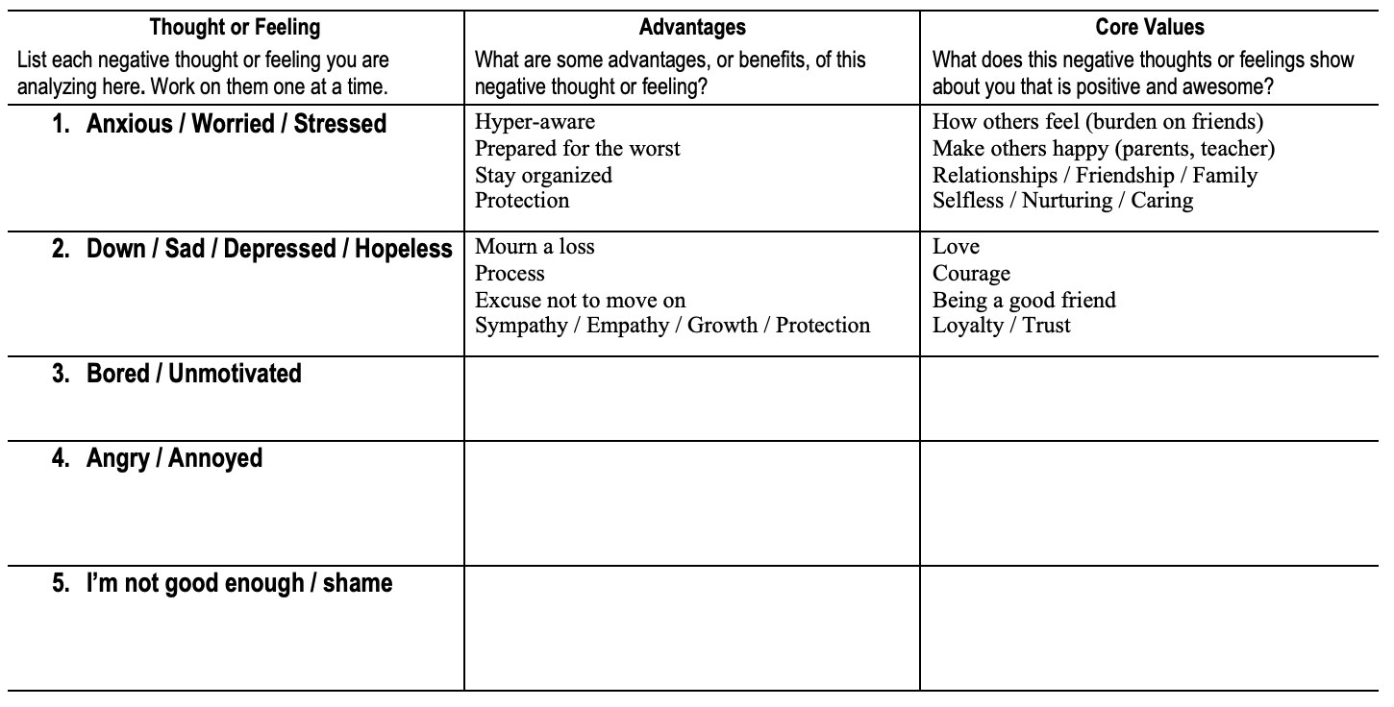
Positive Reframing

Slide 8
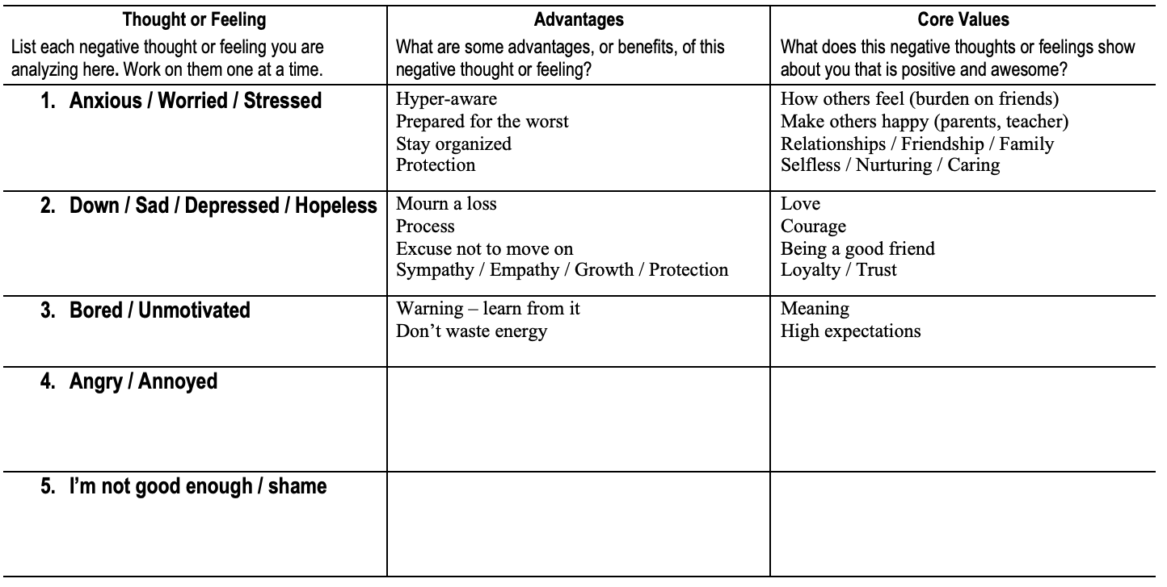
Positive Reframing

Slide 9
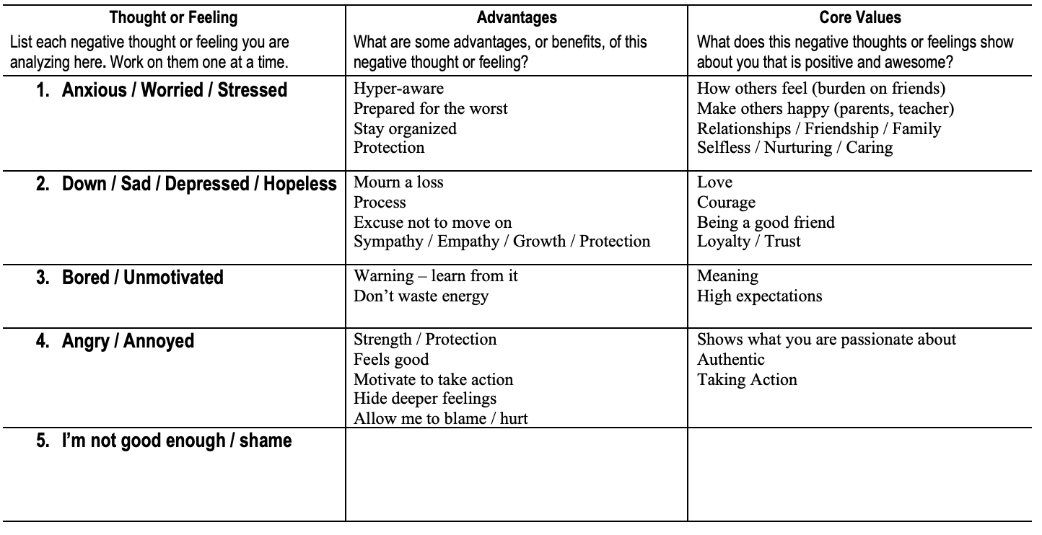
Positive Reframing

Slide 10
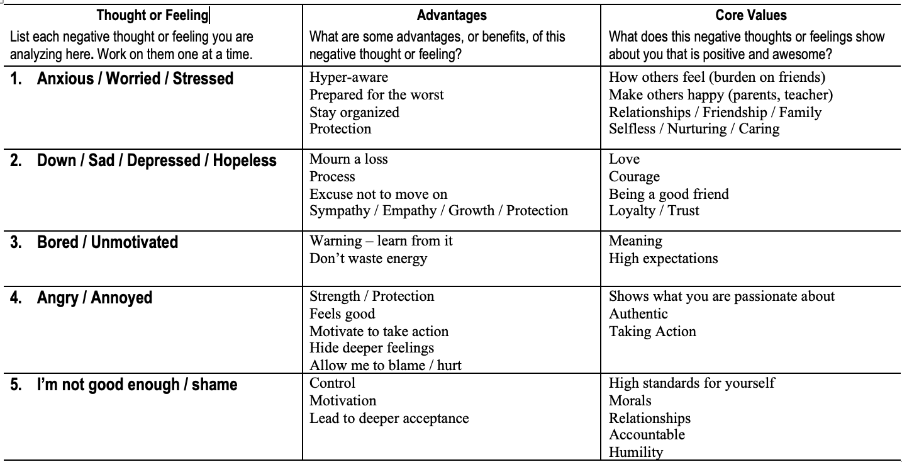
Positive Reframing

Slide 11
Why this matters
Understanding your emotions is the first step to feeling better
Learn when feelings are healthy (grief) and unhealthy (hopeless)
Accept all of you (defaults and all)
Verbalize how you feel
Challenge the unhealthy feelings (next week)

Slide 12
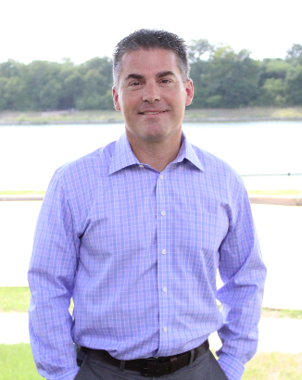
Resources
Chris Guzniczak, Feedback from individual clients, 2019, 2020
David D Burns MD, from Tools not Schools, copyright 2013
Chris Guzniczak, Licensed Professional Counselor
Flower Mound Counseling
(214) 918-9569
chrisguz.counseling@gmail.com
www.chrisguzniczakcounseling.com
This presentation is for informational purposes only and is not intended to be advice
or counseling

